Slide 1
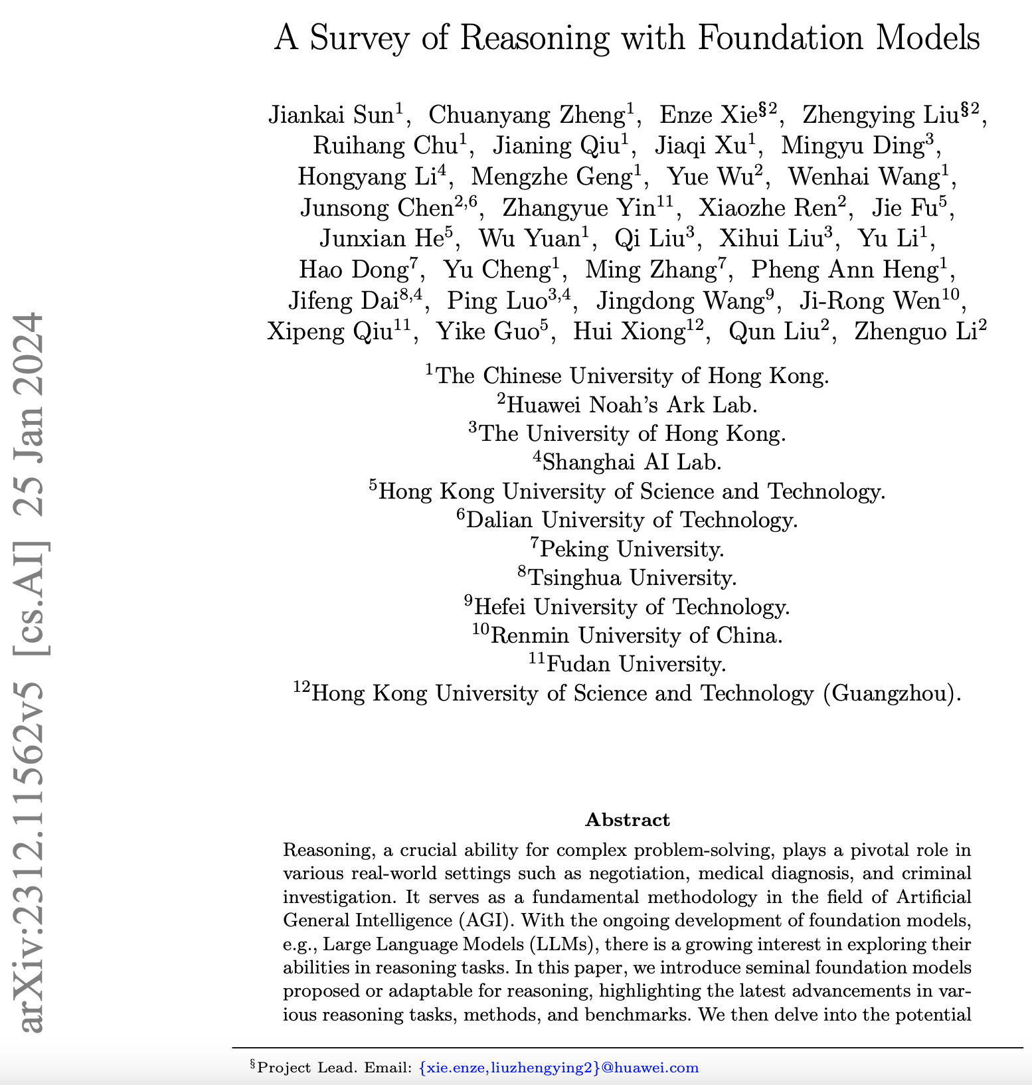

A Survey of Reasoning with Foundation Models
Asim Munawar
Survey of 650+ papers

Slide 2
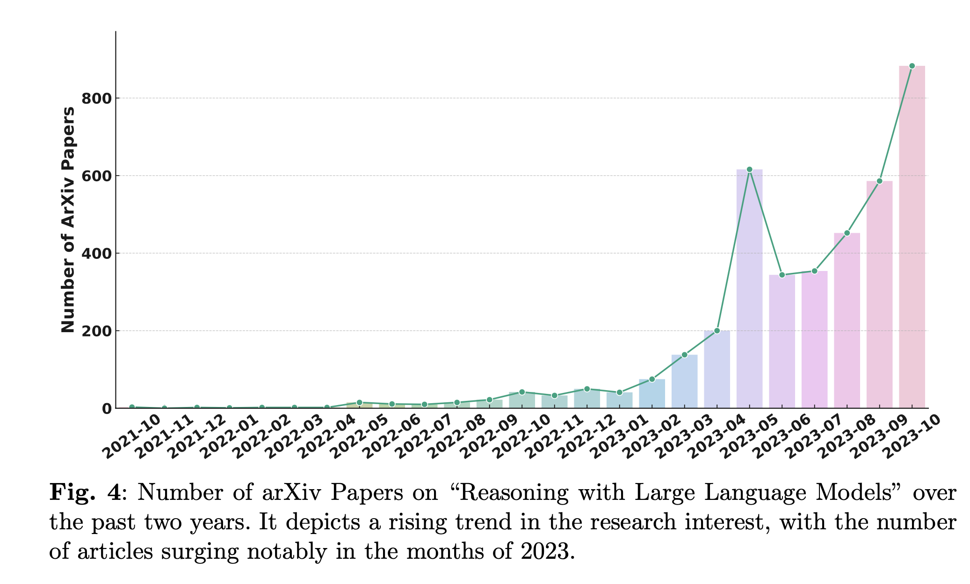

Why Reasoning?
Reasoning, is a crucial ability for complex problem-solving
Plays a pivotal role in various real-world settings such as diagnosis, approvals, decision making etc.
Fundamental methodology in the progress towards Artificial General Intelligence (AGI).
A lot of interest in context of Large Language Models (LLMs).
Adding reasoning can significantly improve the results.

Slide 3
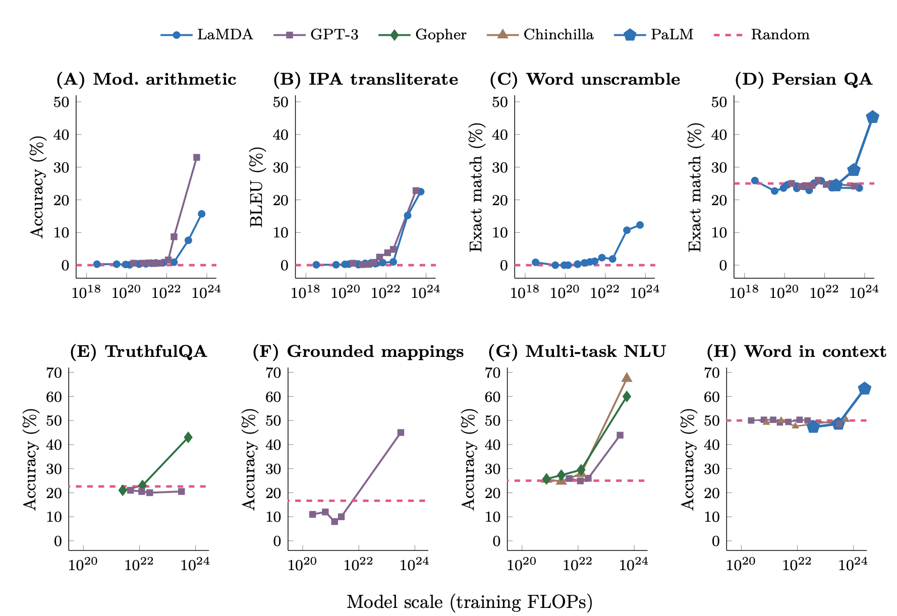
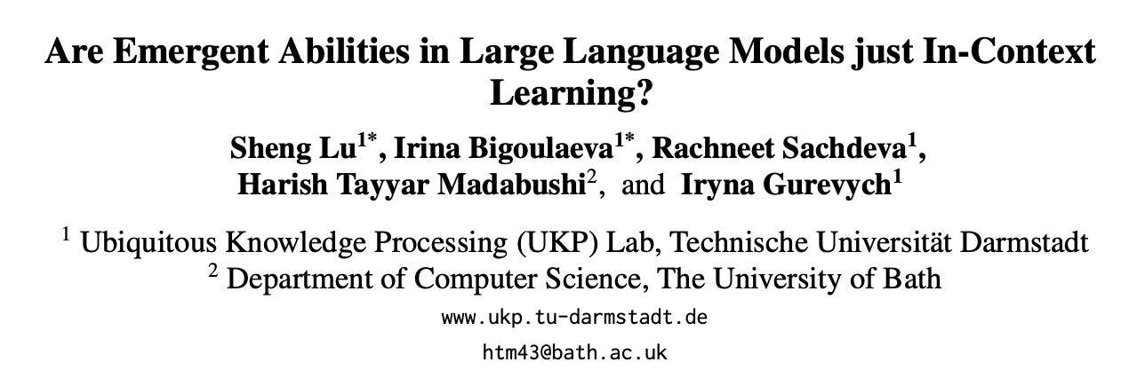
Emergent abilities of LLMs
An ability is emergent if it is not present in smaller models but is present in larger models
Size of a model depends on
Training FLOPs
Number of model parameters
Training data size
Argues against it
Emergent Abilities of Large Language Models
Jason Wei et al.
Notes:
Source: https://youtu.be/0Z1ZwY2K2-M?t=207

Slide 4
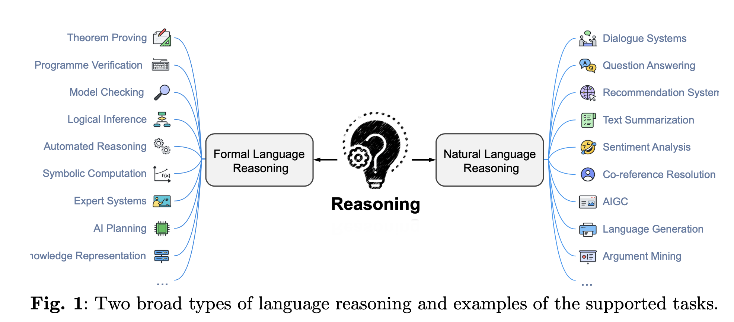
Broad types of reasoning
Very general definition of NL reasoning

Slide 5
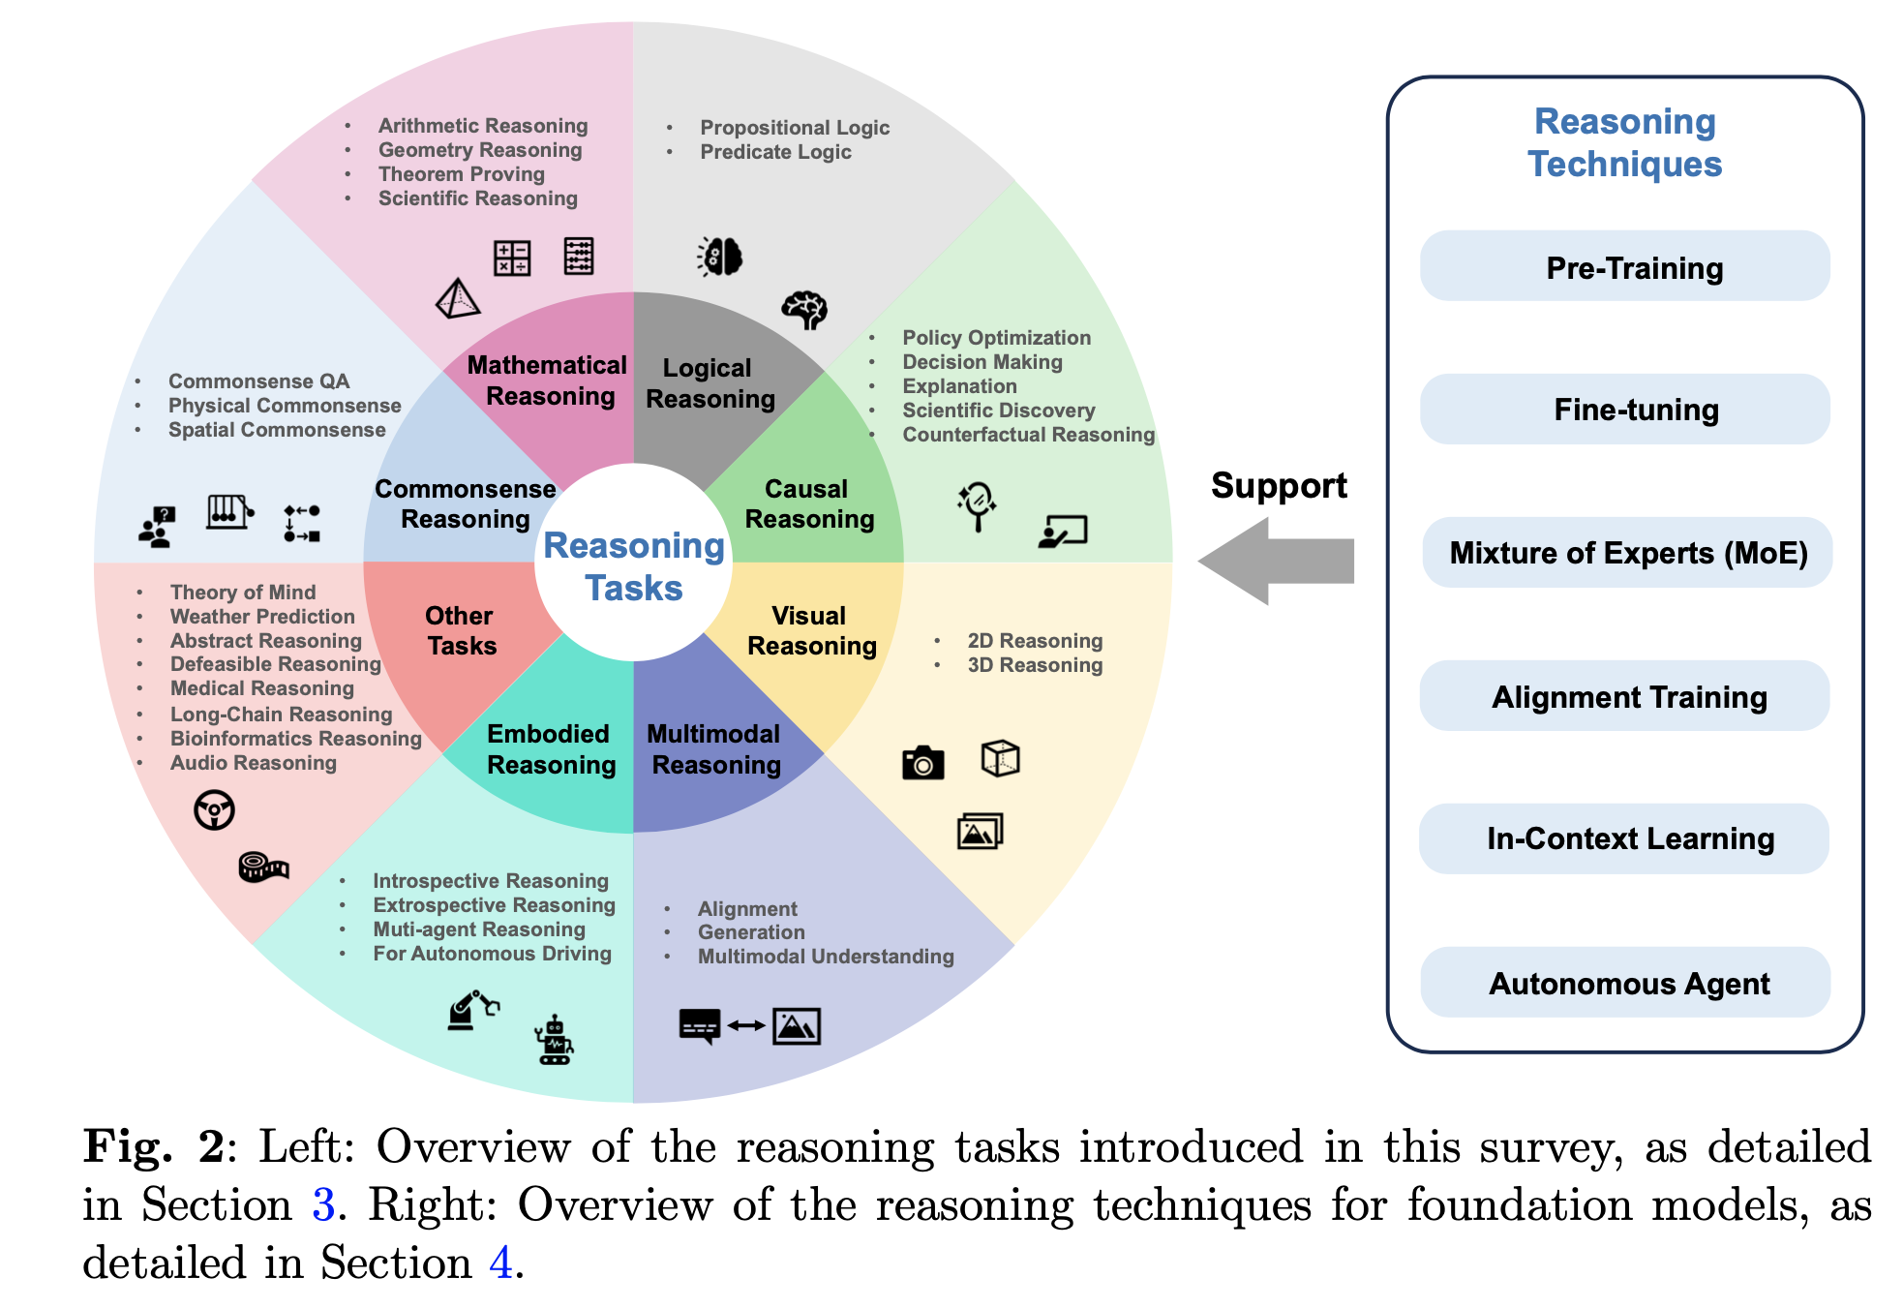

Slide 6
Definition of Reasoning
Definition 1. (Cognitive reasoning). Cognitive reasoning refers to modeling the human ability to draw meaningful conclusions despite incomplete and inconsistent knowledge involving among others the representation of knowledge where all processes from the acquisition and update of knowledge to the derivation of conclusions must be implementable and executable on appropriate hardware.
Definition 2. (Logical reasoning). Logical reasoning involves a process of thought where conclusions are methodically drawn based on premises and the relationships between these premises, ensuring that the conclusions are logically implied or necessitated by them.
Definition 3. (Natural language reasoning). Natural language reasoning is a process of integrating multiple knowledge (e.g., encyclopedic knowledge and commonsense knowledge) to derive some new conclusions about the (realistic or hypothetical) world. Knowledge can be derived from sources that are both explicit and implicit. Conclusions are assertions or events assumed to be true in the world, or practical actions.

Slide 7
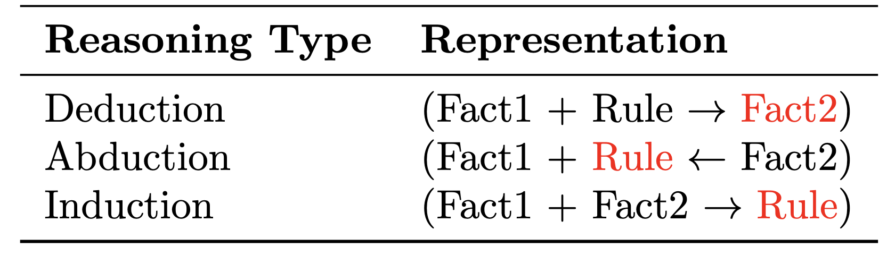
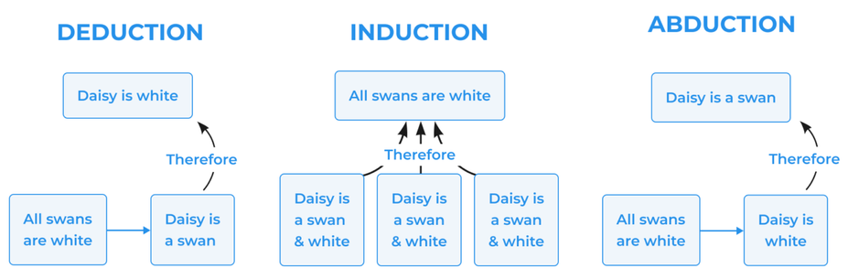
Types of Reasoning
It follows a top-down approach, starting with general principles and applying logical rules to reach specific conclusions. Deductive reasoning aims to provide logically valid and conclusive results.
Inferring the best possible explanation from incomplete or limited information.
Moves from specific instances to broader generalizations. Inductive reasoning does not guarantee absolute certainty but provides probable conclusions based on available evidence.
Source: https://mconsultingprep.com/what-is-deductive-reasoning

Slide 8
Taxonomies of Reasoning Tasks
Formal Reasoning vs. Informal Reasoning: Formal reasoning involves following strict rules, logical frame-works, or formal systems to derive conclusions and often relies on mathematical or deductive reasoning. Informal reasoning, on the other hand, is less structured and more intuitive, relying on personal experiences, common sense, and heuristics.
Neural Reasoning vs. Symbolic Reasoning vs. Neural-Symbolic Reasoning: This taxonomy is based on the underlying computational framework used for reasoning. Neural reasoning refers to approaches that utilize neural networks or deep learning models for reasoning tasks. Symbolic reasoning involves using symbolic representations, logic-based inference rules, or symbolic manipulation for reasoning. Neural-symbolic reasoning combines elements of both neural networks and symbolic reasoning, aiming to integrate their respective strengths.
Backward Reasoning vs. Forward Reasoning: This taxonomy is based on the direction of the reasoning process. Backward reasoning starts from a goal or desired outcome and works backward by applying rules or evidence to determine the necessary conditions or steps to reach that goal. Forward reasoning starts with initial premises or evidence and progresses step-by-step to derive new conclusions or reach a final outcome.
Single-step Reasoning vs. Multi-step: This taxonomy is based on the complexity or number of steps involved in the reasoning process. Multi-step reasoning refers to tasks that require multiple sequential or interconnected steps to arrive at a solution or conclusion. It involves chaining together intermediate steps or inferences to reach the final result.
Deductive Reasoning vs. Defeasible Reasoning: The classification criterion for this type of reasoning is based on the nature of the reasoning process and the handling of exceptions or conflicting information. Defeasible reasoning involves reasoning under uncertainty or with incomplete information, where conclusions can be overridden or defeated by new evidence or exceptions. It allows for the revision or reevaluation of conclusions based on additional information or context.
Unimodal Reasoning vs. Multimodal Reasoning: This taxonomy is based on the input modalities used in the reasoning process. Unimodal reasoning refers to reasoning tasks that involve a single modality of information or input, for example, reasoning tasks that are based solely on language information. Multimodal reasoning, on the other hand, involves integrating and reasoning with multiple modalities of information simultaneously. This could include combining visual, language, textual, auditory, or other types of input for the reasoning process.
Some other forms: factual reasoning, counterfactual reasoning, plausible (defeasible) reasoning, default reasoning, and abstract reasoning

Slide 9
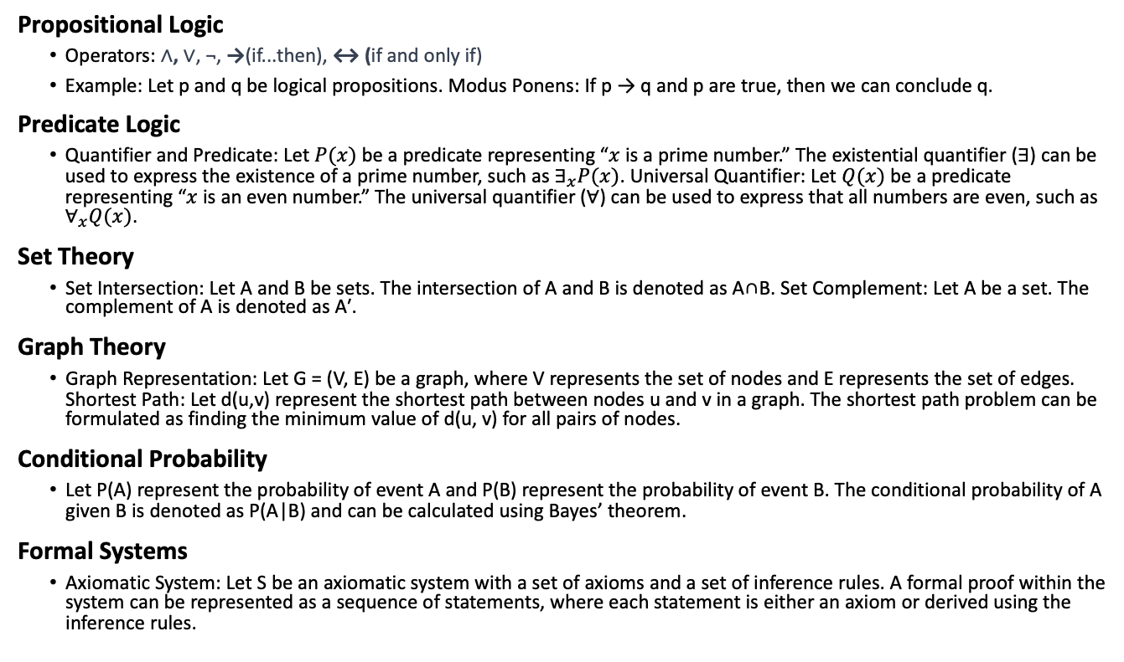
Mathematical Representations for Reasoning
Propositional Logic
Operators: ∧, ∨, ¬, →(if...then), ↔ (if and only if)
Example: Let p and q be logical propositions. Modus Ponens: If p → q and p are true, then we can conclude q.
Predicate Logic
Quantifier and Predicate: Let $P(x)$be a predicate representing “$x$ is a prime number.” The existential quantifier (∃) can be used to express the existence of a prime number, such as $∃_{x}P(x)$. Universal Quantifier: Let $Q(x)$ be a predicate representing “$x$ is an even number.” The universal quantifier ($∀$) can be used to express that all numbers are even, such as $∀_{x}Q(x)$.
Set Theory
Set Intersection: Let A and B be sets. The intersection of A and B is denoted as A∩B. Set Complement: Let A be a set. The complement of A is denoted as A′.
Graph Theory
Graph Representation: Let G = (V, E) be a graph, where V represents the set of nodes and E represents the set of edges. Shortest Path: Let d(u,v) represent the shortest path between nodes u and v in a graph. The shortest path problem can be formulated as finding the minimum value of d(u, v) for all pairs of nodes.
Conditional Probability
Let P(A) represent the probability of event A and P(B) represent the probability of event B. The conditional probability of A given B is denoted as P(A|B) and can be calculated using Bayes’ theorem.
Formal Systems
Axiomatic System: Let S be an axiomatic system with a set of axioms and a set of inference rules. A formal proof within the system can be represented as a sequence of statements, where each statement is either an axiom or derived using the inference rules.

Slide 10
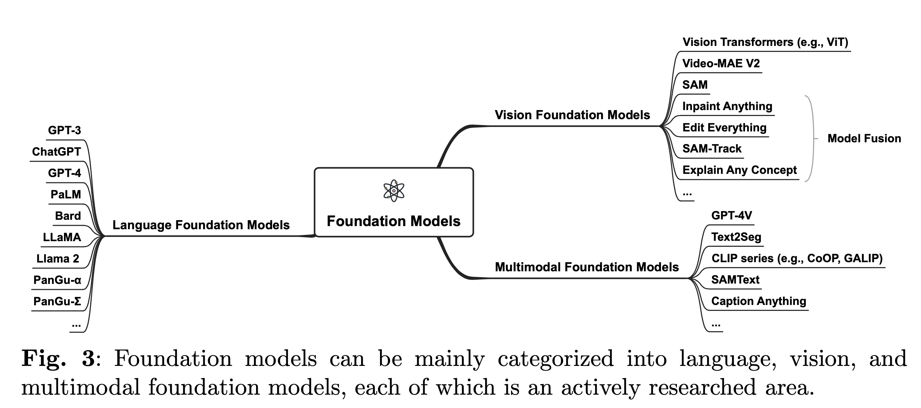
Examples of Foundation Models

Slide 11
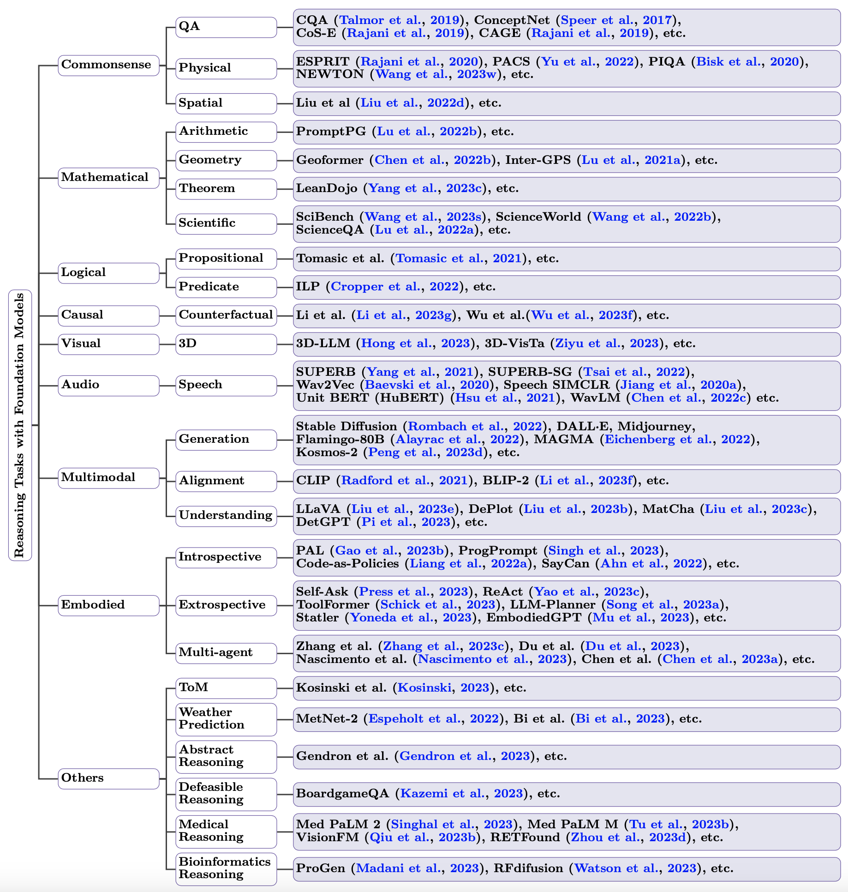
Taxonomy of Reasoning Tasks with Foundation Models Only the representative approaches for each type of task are listed

Slide 12
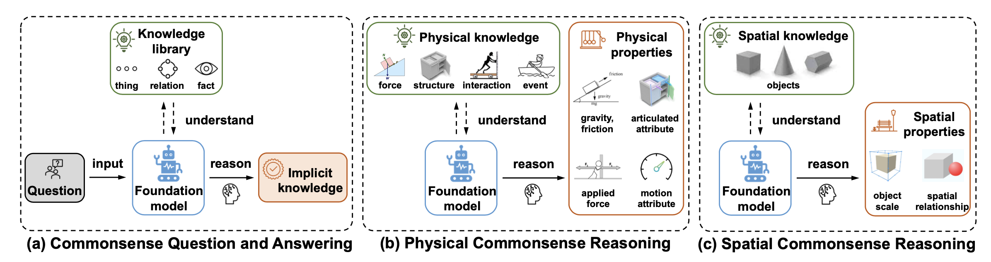
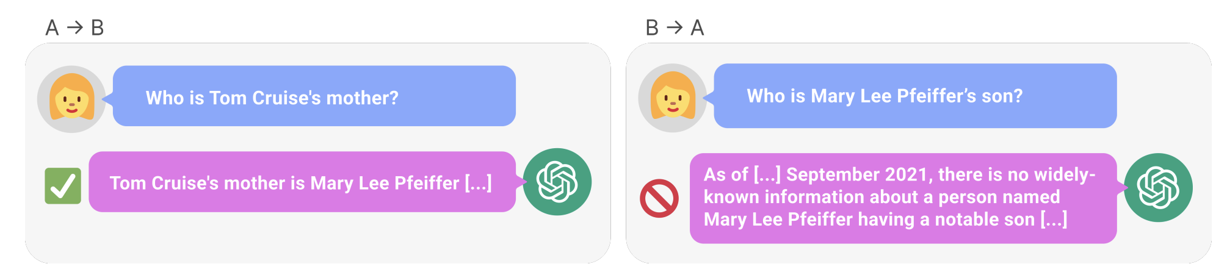
Common Sense Reasoning with FMs
By understanding everyday knowledge, foundation models can reason about implicit knowledge from questions and deduce answers.
Berglund L et al. (2023) The reversal curse: Llms trained on” a is b” fail to learn” b is a”. arXiv preprint arXiv:230912288
Example:

Slide 13
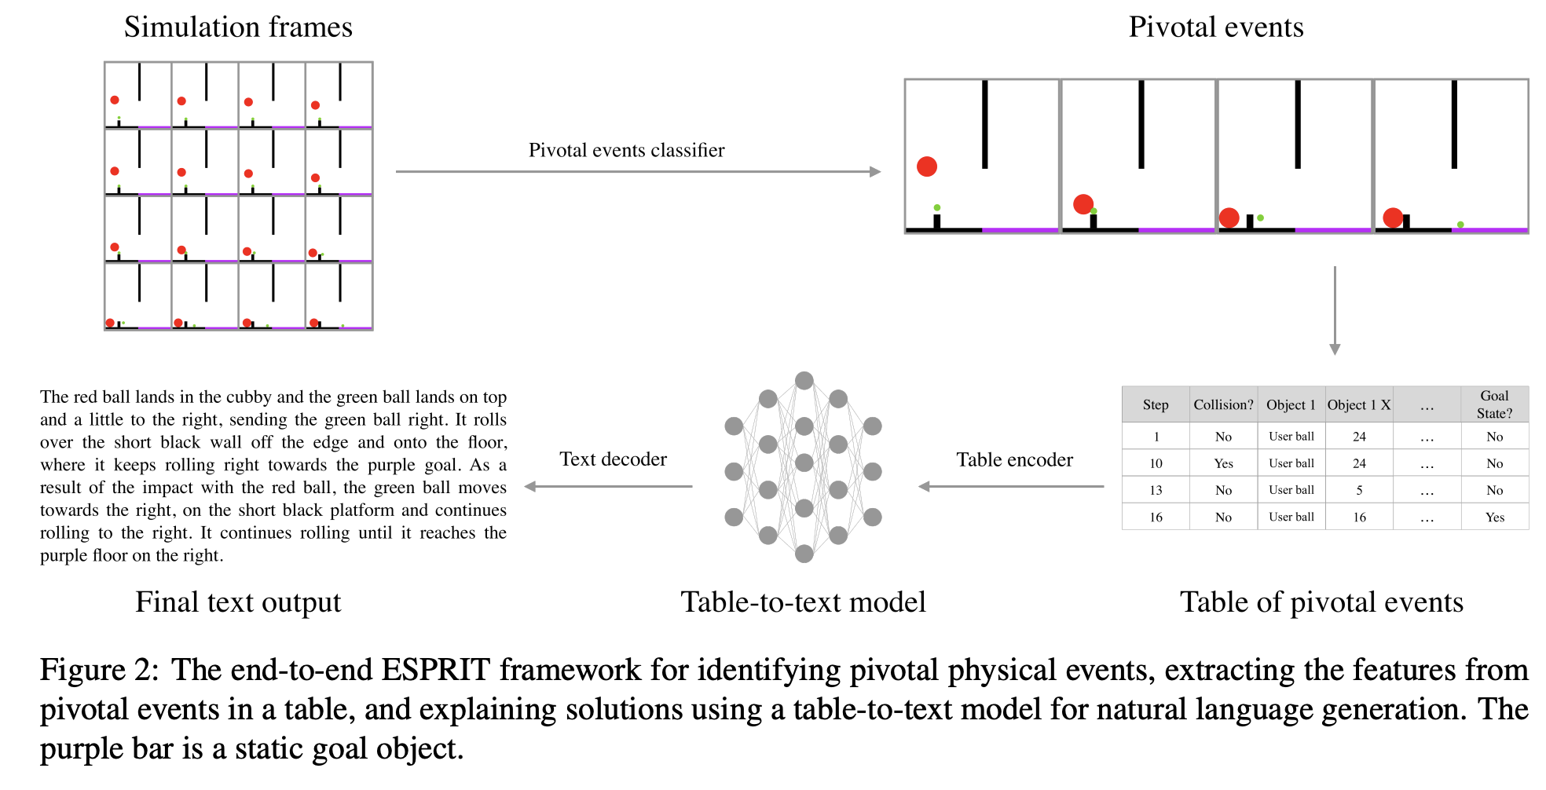
Common Sense Reasoning with FMs
Foundation models infer a wide range of physical properties from general physical knowledge.
Explaining Solutions to Physical ReasonIng Tasks (ESPRIT) framework (Rajani et al., 2020) combines commonsense physical reasoning with interpretability via natural language explanations. It operates in two stages:
Pinpointing key physical events in tasks
Crafting natural language descriptions for both the initial scene and these crucial events (data → text)
The framework aims to provide a unified approach to reasoning about commonsense physical concepts, such as gravity, friction, and collision, while also offering qualitative explanations using natural language. PACS (Physical Audiovisual CommonSense)

Slide 14
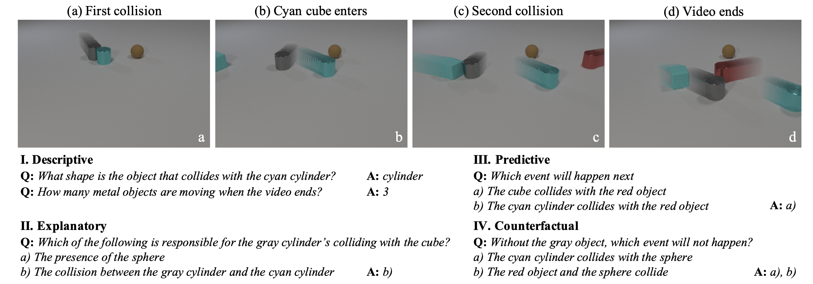
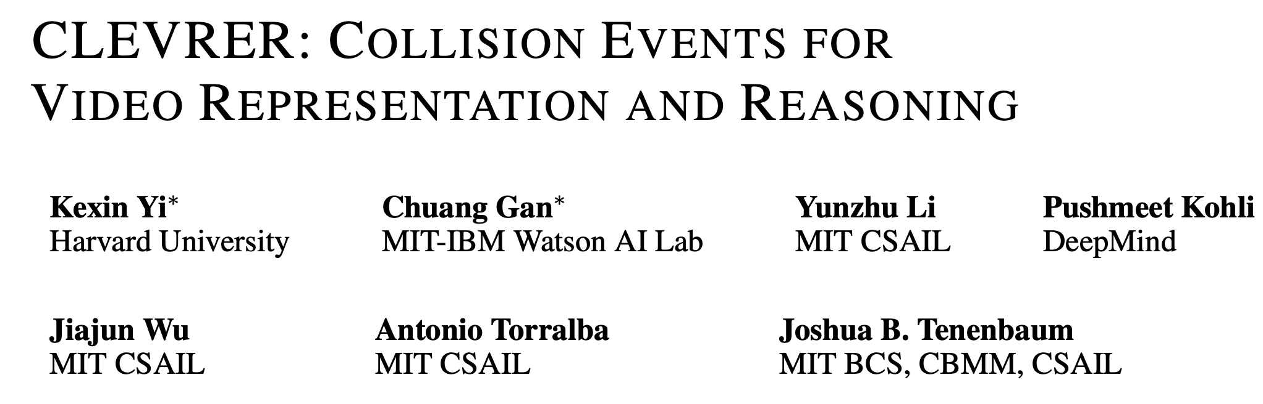
Common Sense Reasoning with FMs
Foundation models infer a wide range of physical properties from general physical knowledge.

Slide 15
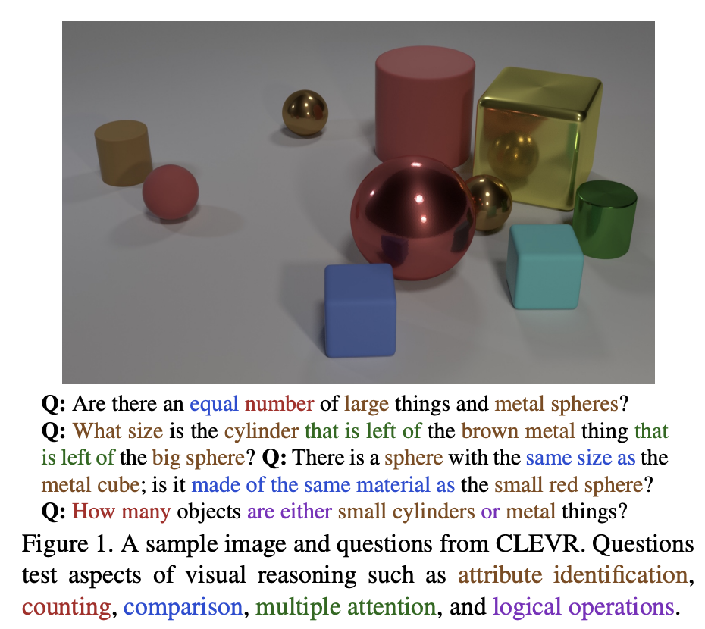
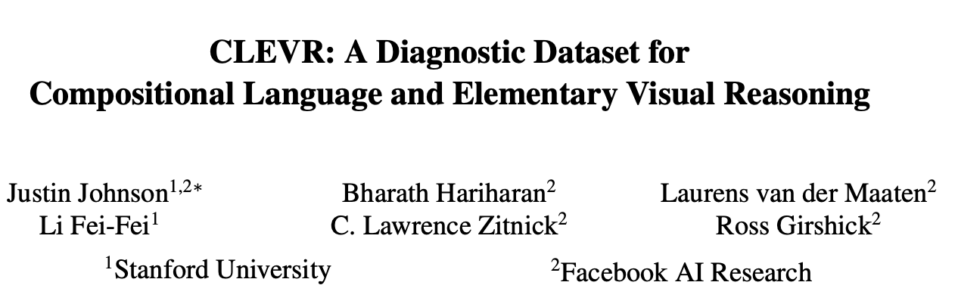
Common Sense Reasoning with FMs
Foundation models reason about spatial properties from a set of objects.
Two significant perspectives
Object scales (Aroca-Ouellette et al., 2021)
Spatial relationship (Hudson and Manning, 2019)

Slide 16
Mathematical Reasoning
Mathematics distinguishes itself as a distinct language that relies on symbolic forms, and precision in meaning and possesses lower dimensionality compared to natural language.
This unique characteristic allows us to demonstrate that meaning can be derived from a set of learned rule sets, as exemplified by the symbolic representations of mathematical concepts (Floyd, 2004).
Converting natural language instruction into a computer program falls in this category.

Slide 17
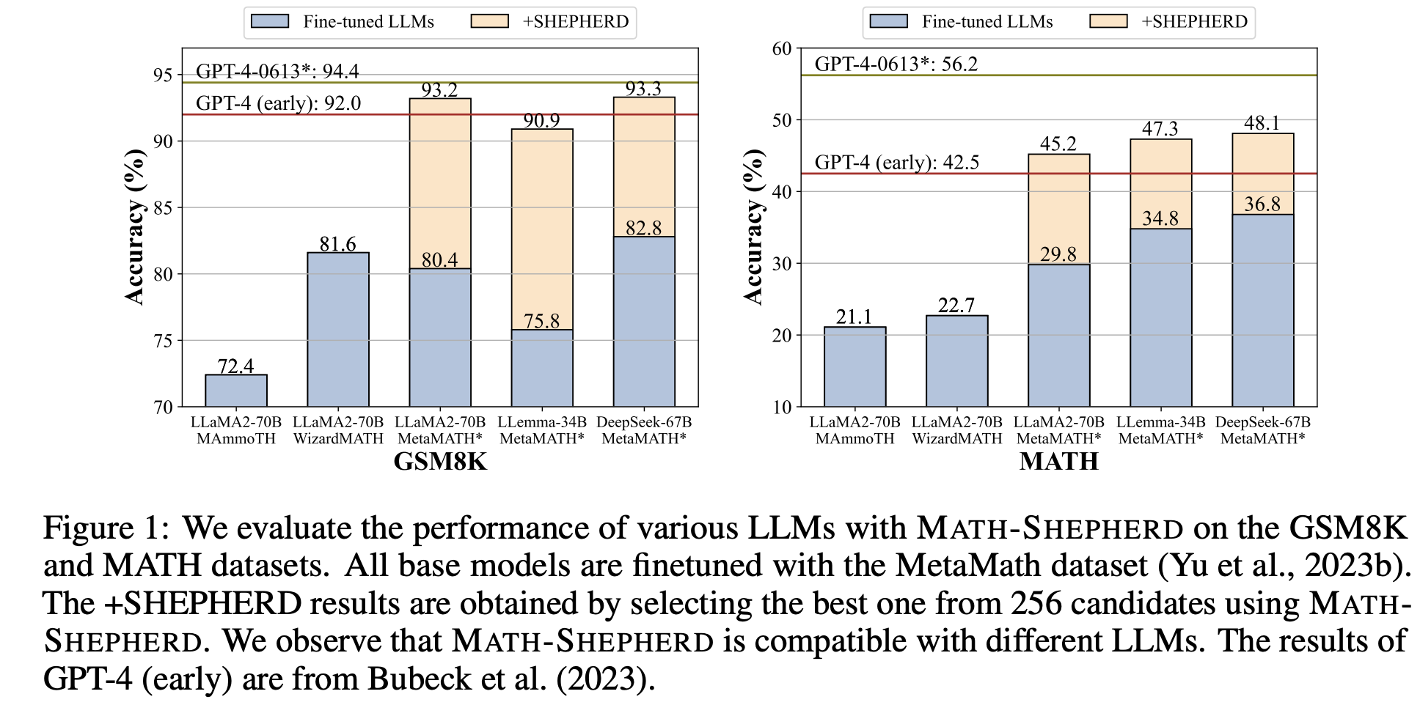
Arithmetic Reasoning
Math Word Problems (MWPs) are commonly used to evaluate the arithmetic reasoning abilities of language models.
Problems may appear uncomplicated to humans; language models frequently encounter challenges when it comes to tasks involving arithmetic reasoning.
MATH-SHEPHERD - Wang et al. (2023n) introduce, a novel process-oriented math verifier that evaluates and assigns a reward score to each step in Large Language Models’ (LLMs) solutions to math problems.
Verification: Math-Shepherd is utilized for reranking multiple outputs generated by Large Language Models (LLMs);
Reinforcement Learning: Math-Shepherd is employed to reinforce LLMs with step-by-step Proximal Policy Optimization (PPO).
Results:
Step-by-step PPO with Math-Shepherd significantly improves the accuracy of Mistral-7B (77.9%→84.1% on GSM8K and 28.6%→33.0% on MATH). The accuracy can be further enhanced to 89.1% and 43.5% on GSM8K and MATH with the verification of Math-Shepherd.
Claim that the automatic process supervision holds significant potential.

Slide 18
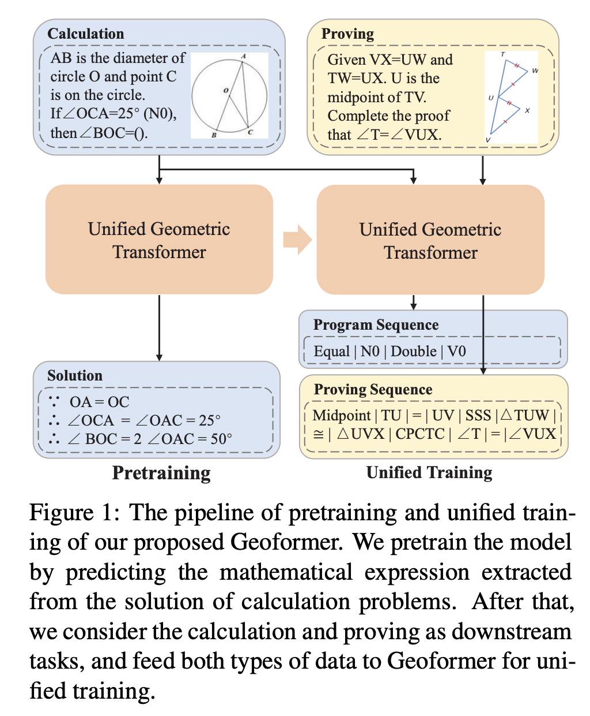
Geometry Reasoning
Geoformer (Chen et al., 2022b) concurrently addresses calculation and proving problems through sequence generation. This approach demonstrates improved reasoning capabilities in both tasks by employing a unified formulation. Additionally, the authors propose the Mathematical Expression Pretraining (MEP) method, predicting mathematical expressions within problem solutions (Chen et al., 2022b).

Slide 19
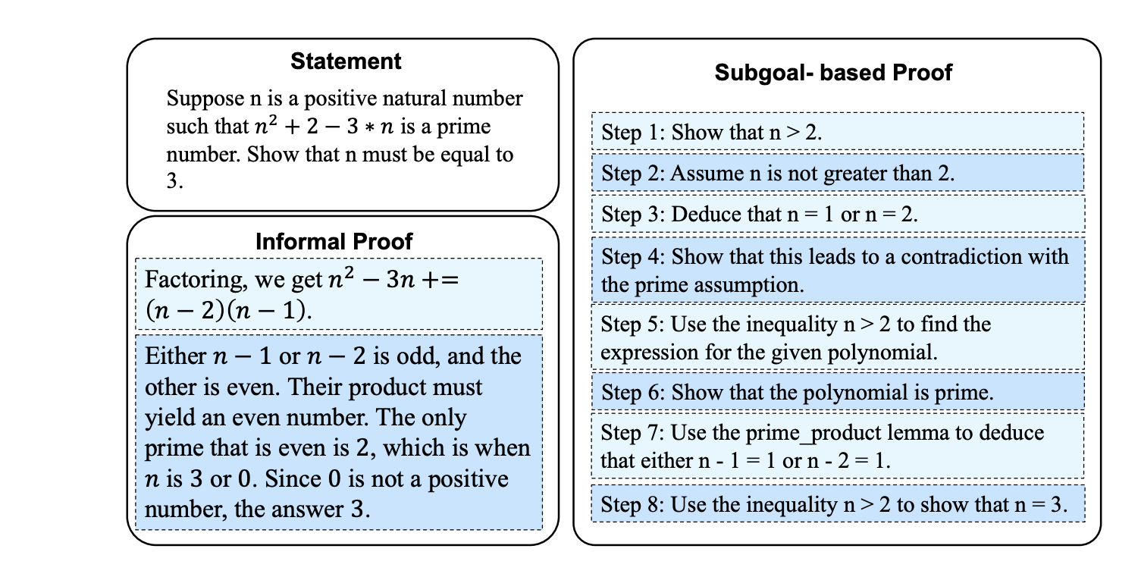
Automated Theorem Proving
Theorem proving is pivotal in both hardware and software verification.
E.g. Companies like Intel have made significant investments in formal methods to ensure the absence of critical floating-point bugs in their processors. A prominent example of the consequences of such bugs is the costly Pentium FDIV bug in 1994, which resulted in a loss of $500 million.
Traditionally, human experts use theorem proving tools → Learnable automated theorem proving holds the potential to revolutionize this field.
Xueliang Zhao et al. Enigma
An Instance of informal proof and subgoal-based proof

Slide 20
Scientific Reasoning
Encompasses the cognitive abilities and problem-solving skills required for formulating, evaluating, and refining hypotheses or theories.
Examples
AI for Physics
AI for Chemistry
AI for Quantum

Slide 21
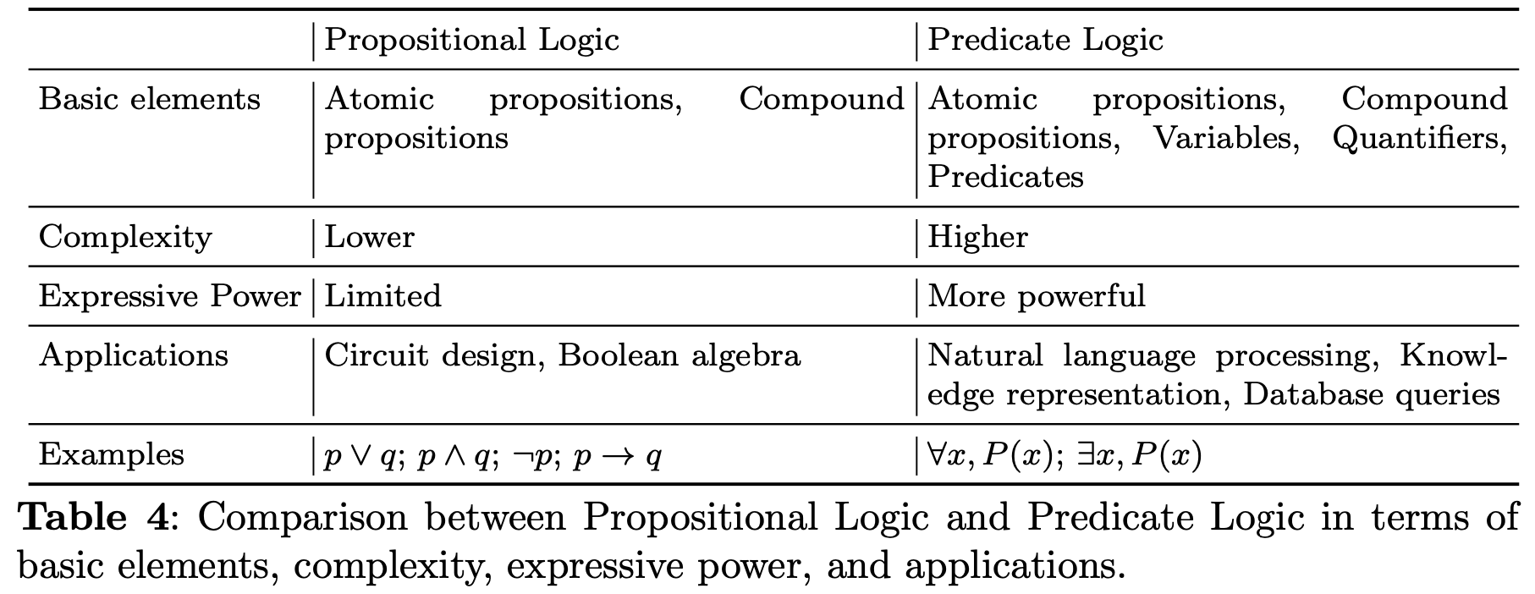
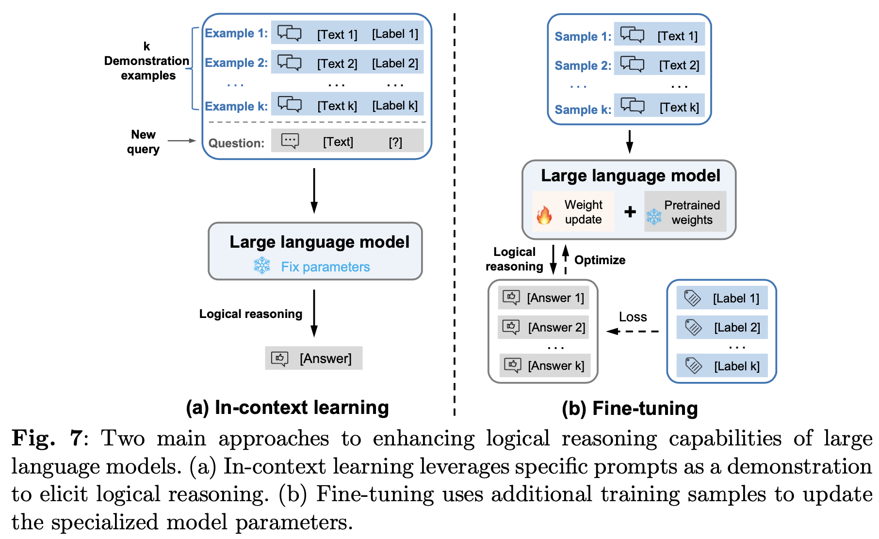
Logical Reasoning
Logical reasoning, covering propositional and predicate logic, is a rigorous form of thinking that involves using premises and their relations to derive conclusions that are implied by the premises.
It can serve as a fundamental basis for various domains in computer science and mathematics.

Slide 22
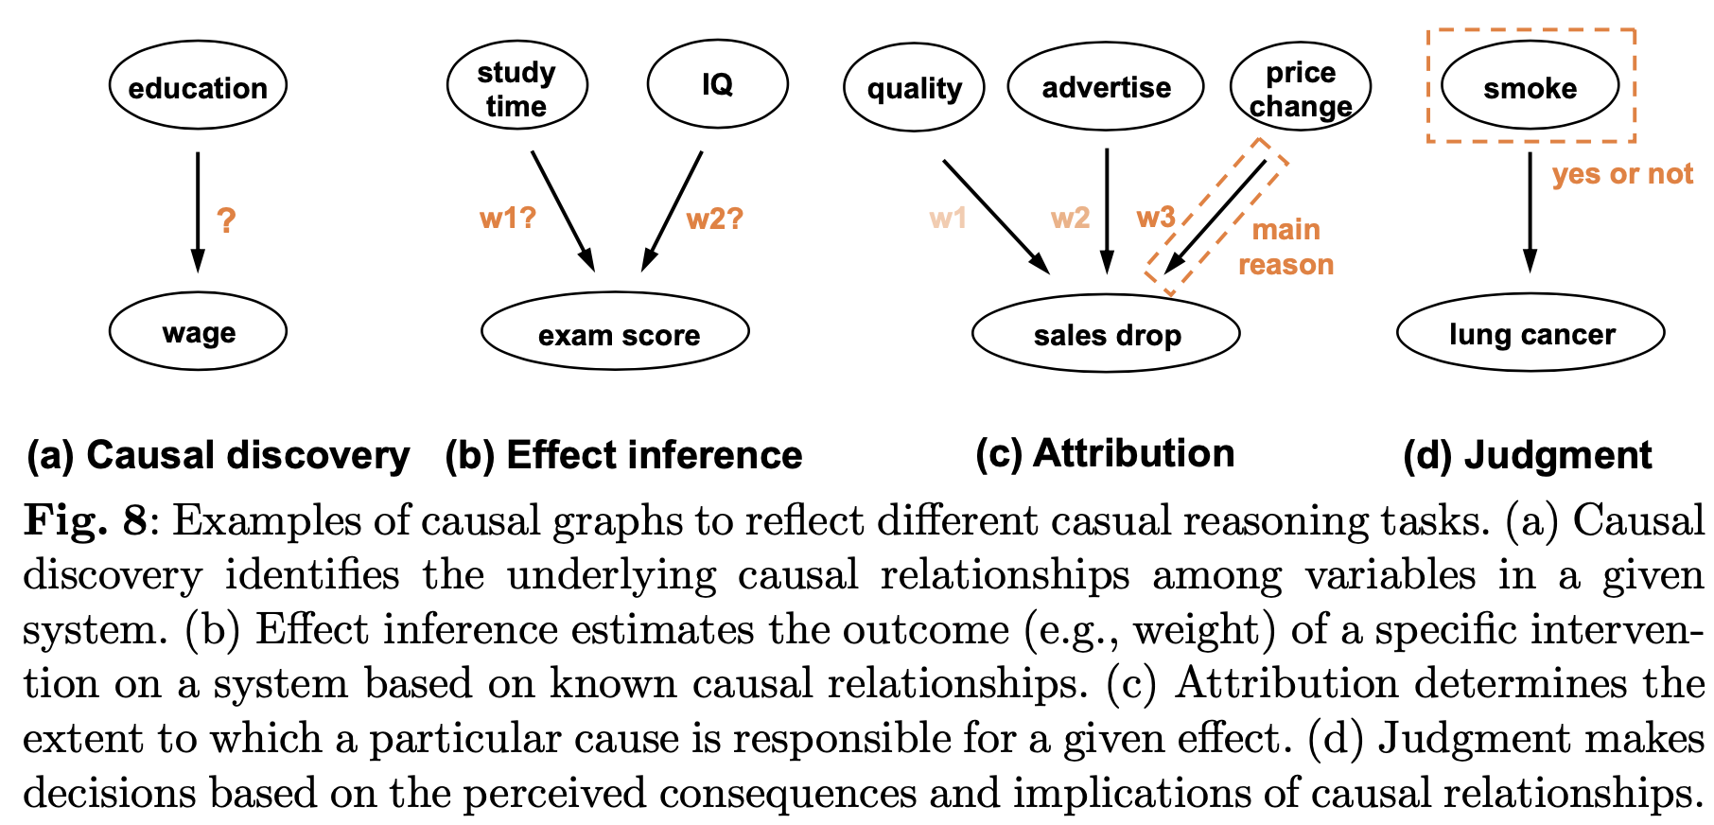
Causal Reasoning
Process of understanding and explaining cause-and-effect relationships between events, actions, or variables.

Slide 23
Counterfactual Reasoning
Counterfactuals involve a premise that is false in the real world but assumed to be true in a hypothetical scenario.
For example, “If cats were vegetarians,” followed by an imaginary consequence like “cats would love cabbages” (Li et al., 2023g).
By subjecting language models to counterfactual testing, we can manipulate the factual accuracy and hypothetical nature of statements, thereby evaluating the models’ capacity to discern and effectively utilize this information in making predictions.
Groundedness – Hallucination tradeoff scenarios

Slide 24
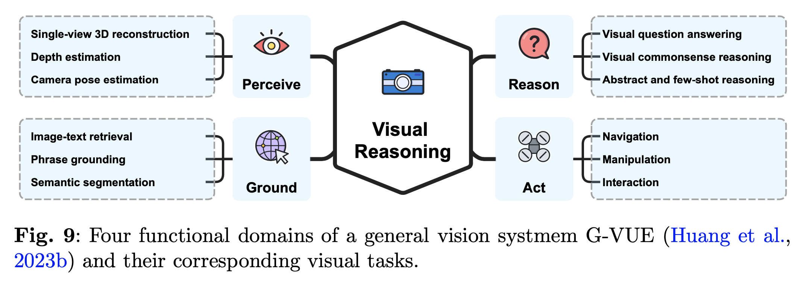
Visual Reasoning
Visual reasoning refers to the cognitive process of understanding, analyzing, and drawing conclusions from visual information. It involves the ability to perceive, interpret, and reason about visual stimuli such as images, scenes, or other visual representations (Ding et al., 2023b).
General-purpose Visual Understanding Evaluation (G-VUE) is a comprehensive evaluation framework (Huang et al., 2023b). It aims to assess the full range of visual cognitive abilities.
3D Reasoning
refers to the cognitive process of understanding, analyzing, and reasoning about 3D objects or spatial arrangements.
3D-LLM (Hong et al., 2023), PointLLM (Xu et al., 2023c) are designed to process 3D point clouds along with their associated features.

Slide 25
Audio Reasoning
Cognitive mechanism of comprehending, examining, and deriving conclusions from auditory data, of which speech is the major source.
Speech representations learned in a self-supervised fashion provide a promising solution in this direction, where a single foundation model is trained and can be applied to a wide spectrum of downstream tasks (Mohamed et al., 2022).
Speech processing can be broadly classified into two distinct categories:
Discriminative tasks
Generative tasks

Slide 26
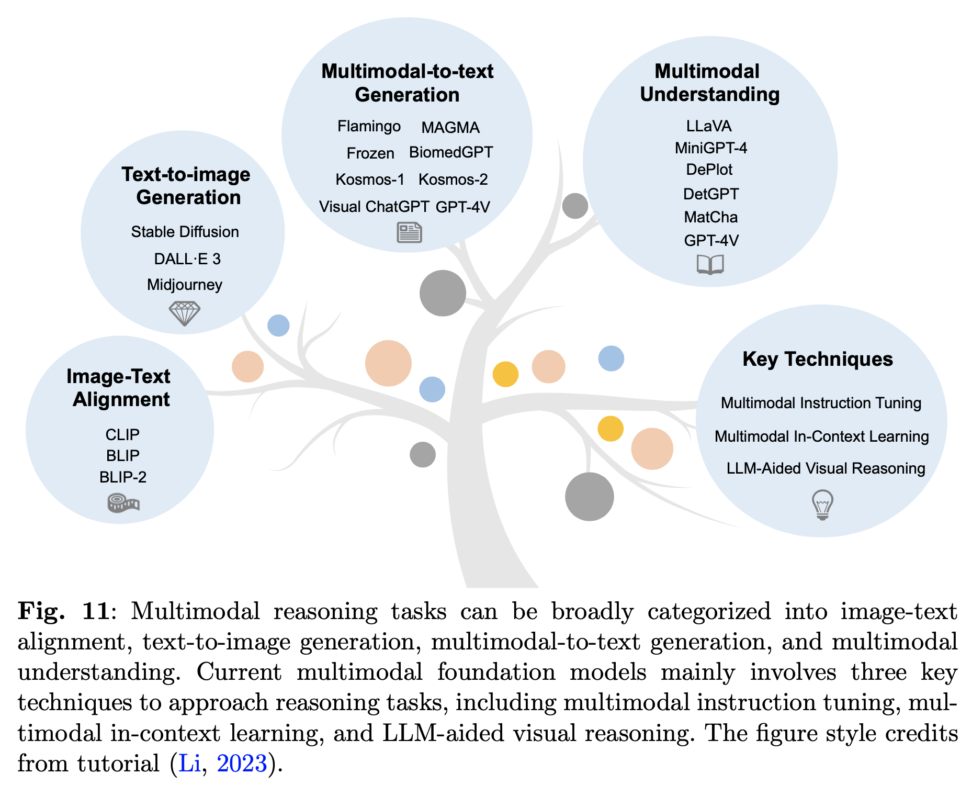
Multimodal Reasoning
Cognitive process of integrating and reasoning across multiple modalities of information, such as text, images, videos, and other sensory inputs, to enhance understanding and perform complex reasoning tasks.

Slide 27
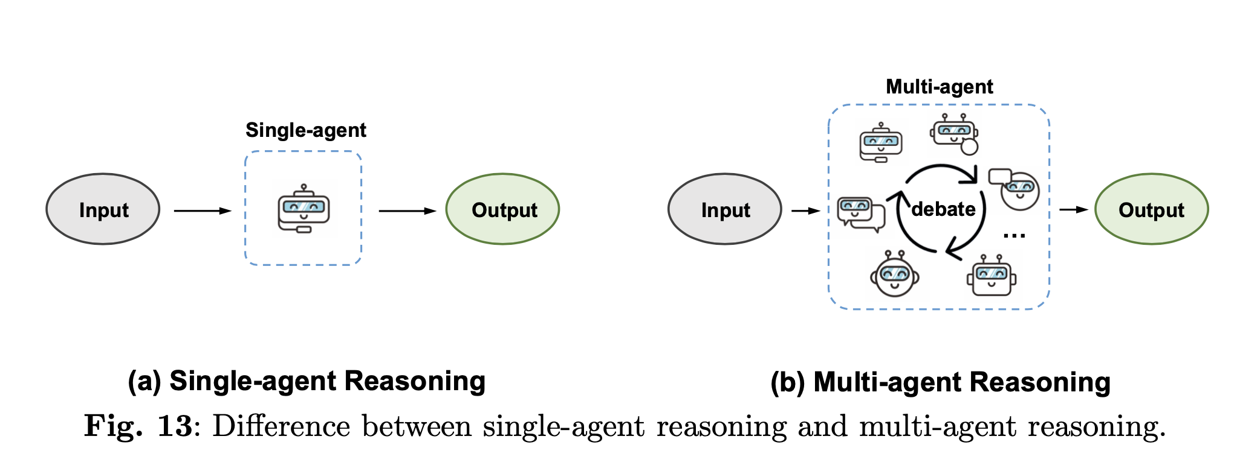
Agent Reasoning
Agent reasoning, is an important capability for the Autonomous Language Agents, which refers to a cognitive process that integrates perception, action, and interaction with the physical environment or simulated environment to support reasoning and problem-solving.
Autonomous Agents in the context of Large Language Models have the ability to perform a wide range of tasks, such as task decomposition, generating code, answering questions, engaging in dialogue, providing recommendations, and more.
Autonomous Agents, often known as AI Agents, harness the power of LLMs to autonomously perform tasks, utilizing their extensive knowledge, reasoning skills, and vast informational resources.

Slide 28
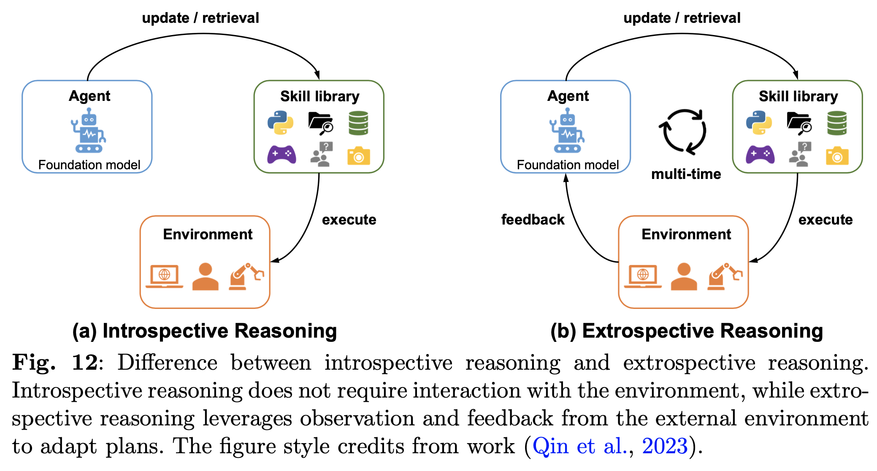
Agent Reasoning
Embodied Reasoning
Cognition is deeply intertwined with bodily experiences and sensorimotor interactions with the environment
Example: Our understanding of concepts like "up" and "down" is grounded in our bodily experiences of gravity and spatial orientation.

Slide 29
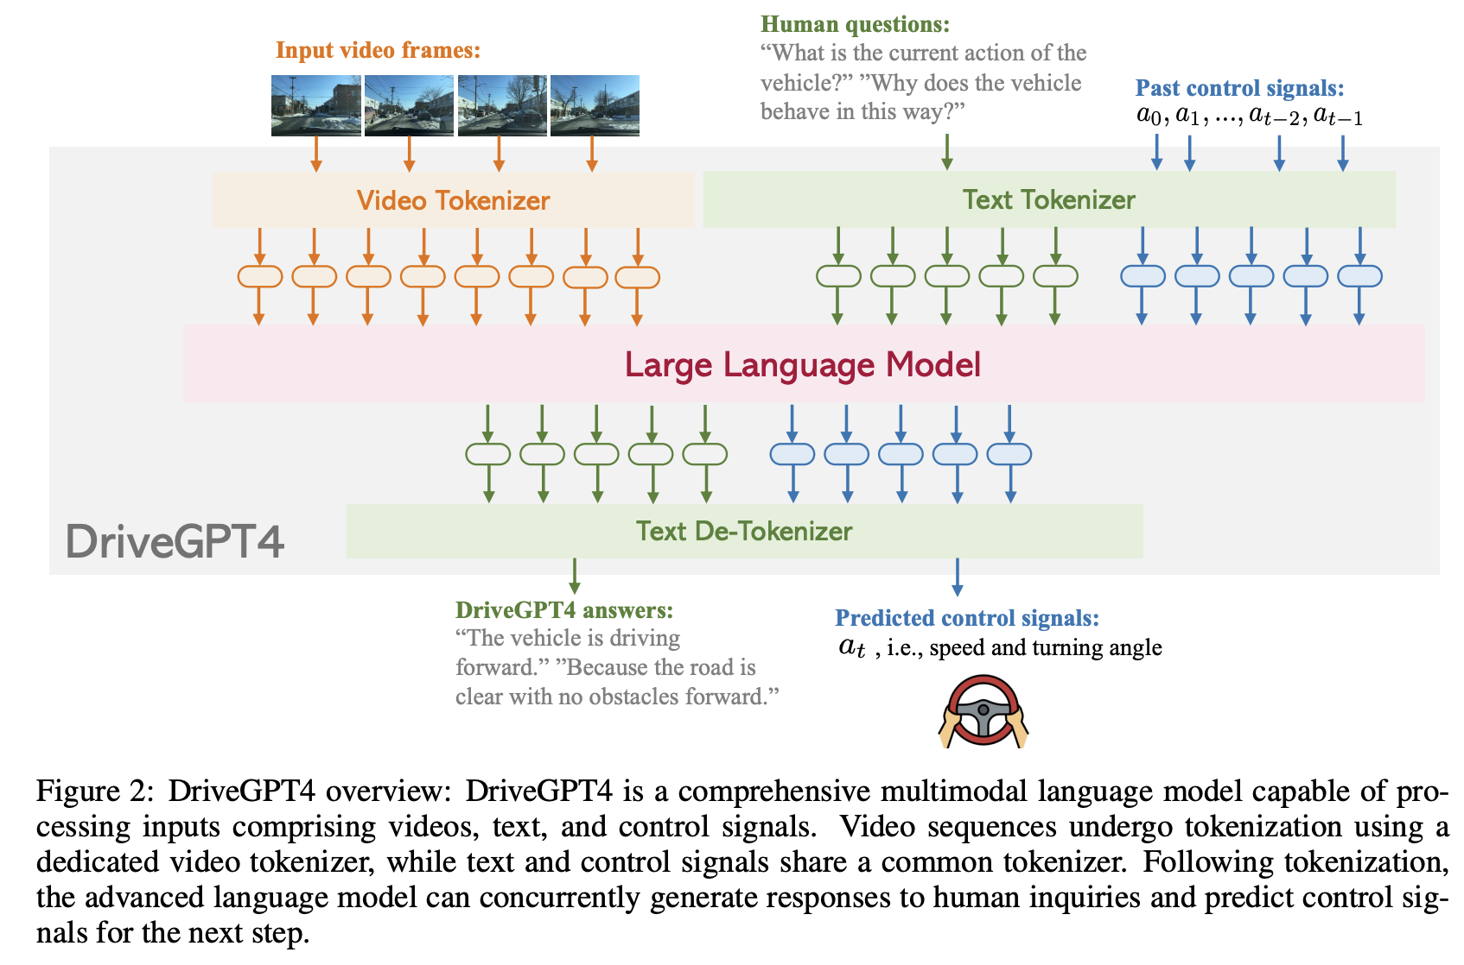
Reasoning in Autonomous Driving
Chen et al. (2023f) propose the frontiers and challenges for end-to-end autonomous driving, where logical reasoning with LLMs could have substantial impacts on different driving scenarios.
Common sense and world knowledge inherited from foundation models could unleash the substantial effectiveness of algorithms onboard to handle corner cases and enhance explainability and safety.
Examples
DriveGPT4 (Xu et al., 2023e) represents a groundbreaking endeavor that harnesses LLMs to comprehend an interpretable end-to-end autonomous driving system. This pioneering effort not only showcases remarkable qualitative but also quantitative achievements when benchmarked against challenging standards.
GPT-Driver (Mao et al., 2023a) and Agent Driver (Mao et al., 2023b) introduce the approach by utilizing LLMs as cognitive agents to operate a tool library.

Slide 30
Other Tasks and Applications
Theory of Mind (ToM)
Ability of a system to understand and interpret the mental states of other agents, such as beliefs, intentions, and emotions, in order to interact with them effectively. Crucial for developing AI systems that can engage in natural and socially intelligent interactions with humans and other agents.
Development of ToM-like ability in models is speculated to have occurred naturally and independently as a consequence of their advancing language skills (Kosinski, 2023)
Weather Forecasting
Medical Reasoning
Best treatment
….
Bioinformatics Reasoning
Drug discovery
Genetic sequence understanding
….
Long Chain Reasoning
Long-chain reasoning is often required in complex problem-solving, decision-making, and understanding of intricate systems.
Code Generation
Abstract Reasoning
Cognitive ability to analyze and manipulate abstract concepts, ideas or symbols without relying on specific contexts or examples.
Gendron et al. (2023) Demonstrate notably limited performance compared to their performance on other NL.
Defeasible Reasoning
Defeasible reasoning refers to a mode of reasoning in which conclusions can be overturned or revised based on new evidence or information.
CURIOUS (Madaan et al., 2021) is a framework that supports defeasible reasoning for humans, utilizing an inference graph (Pollock, 2009).

Slide 31
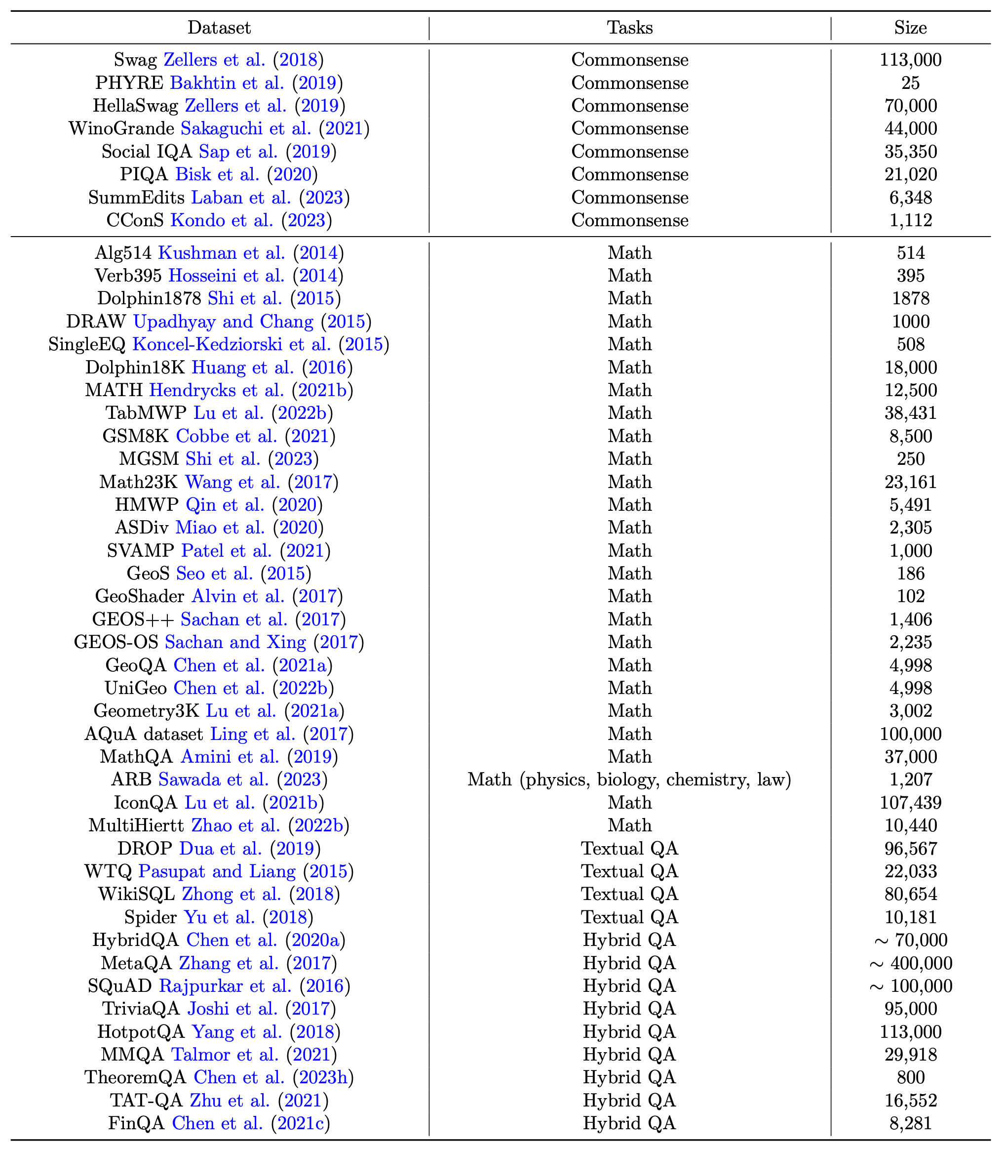
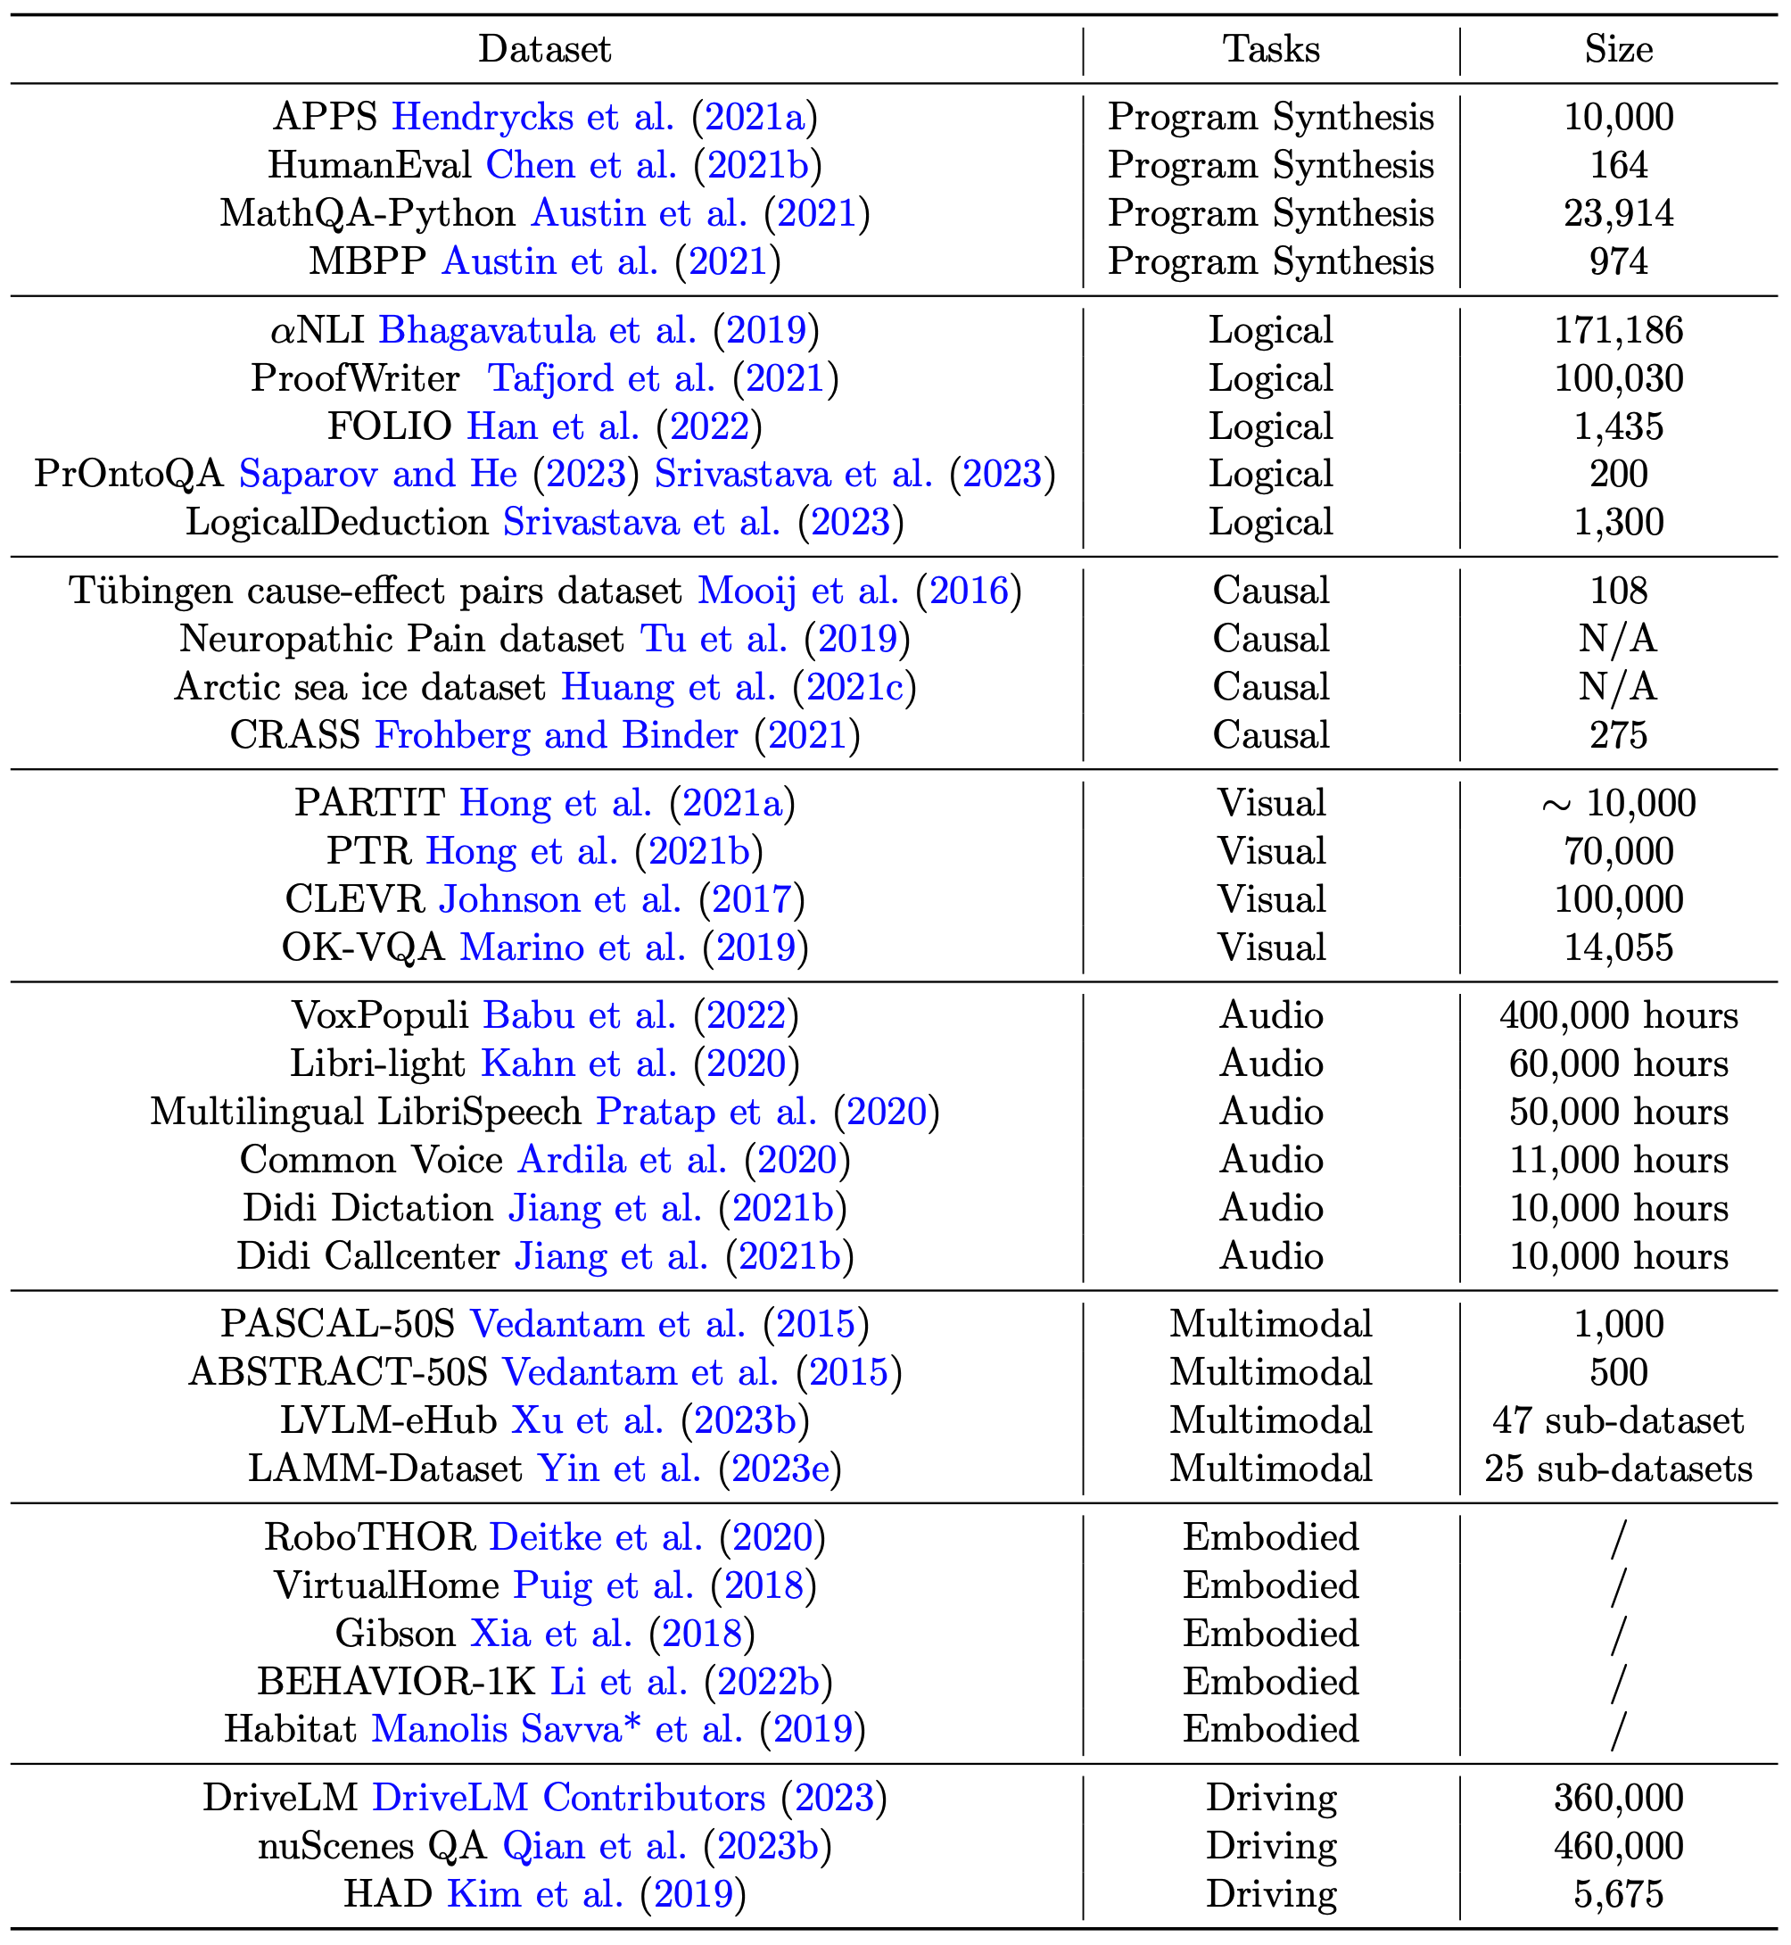
Datasets

Slide 32
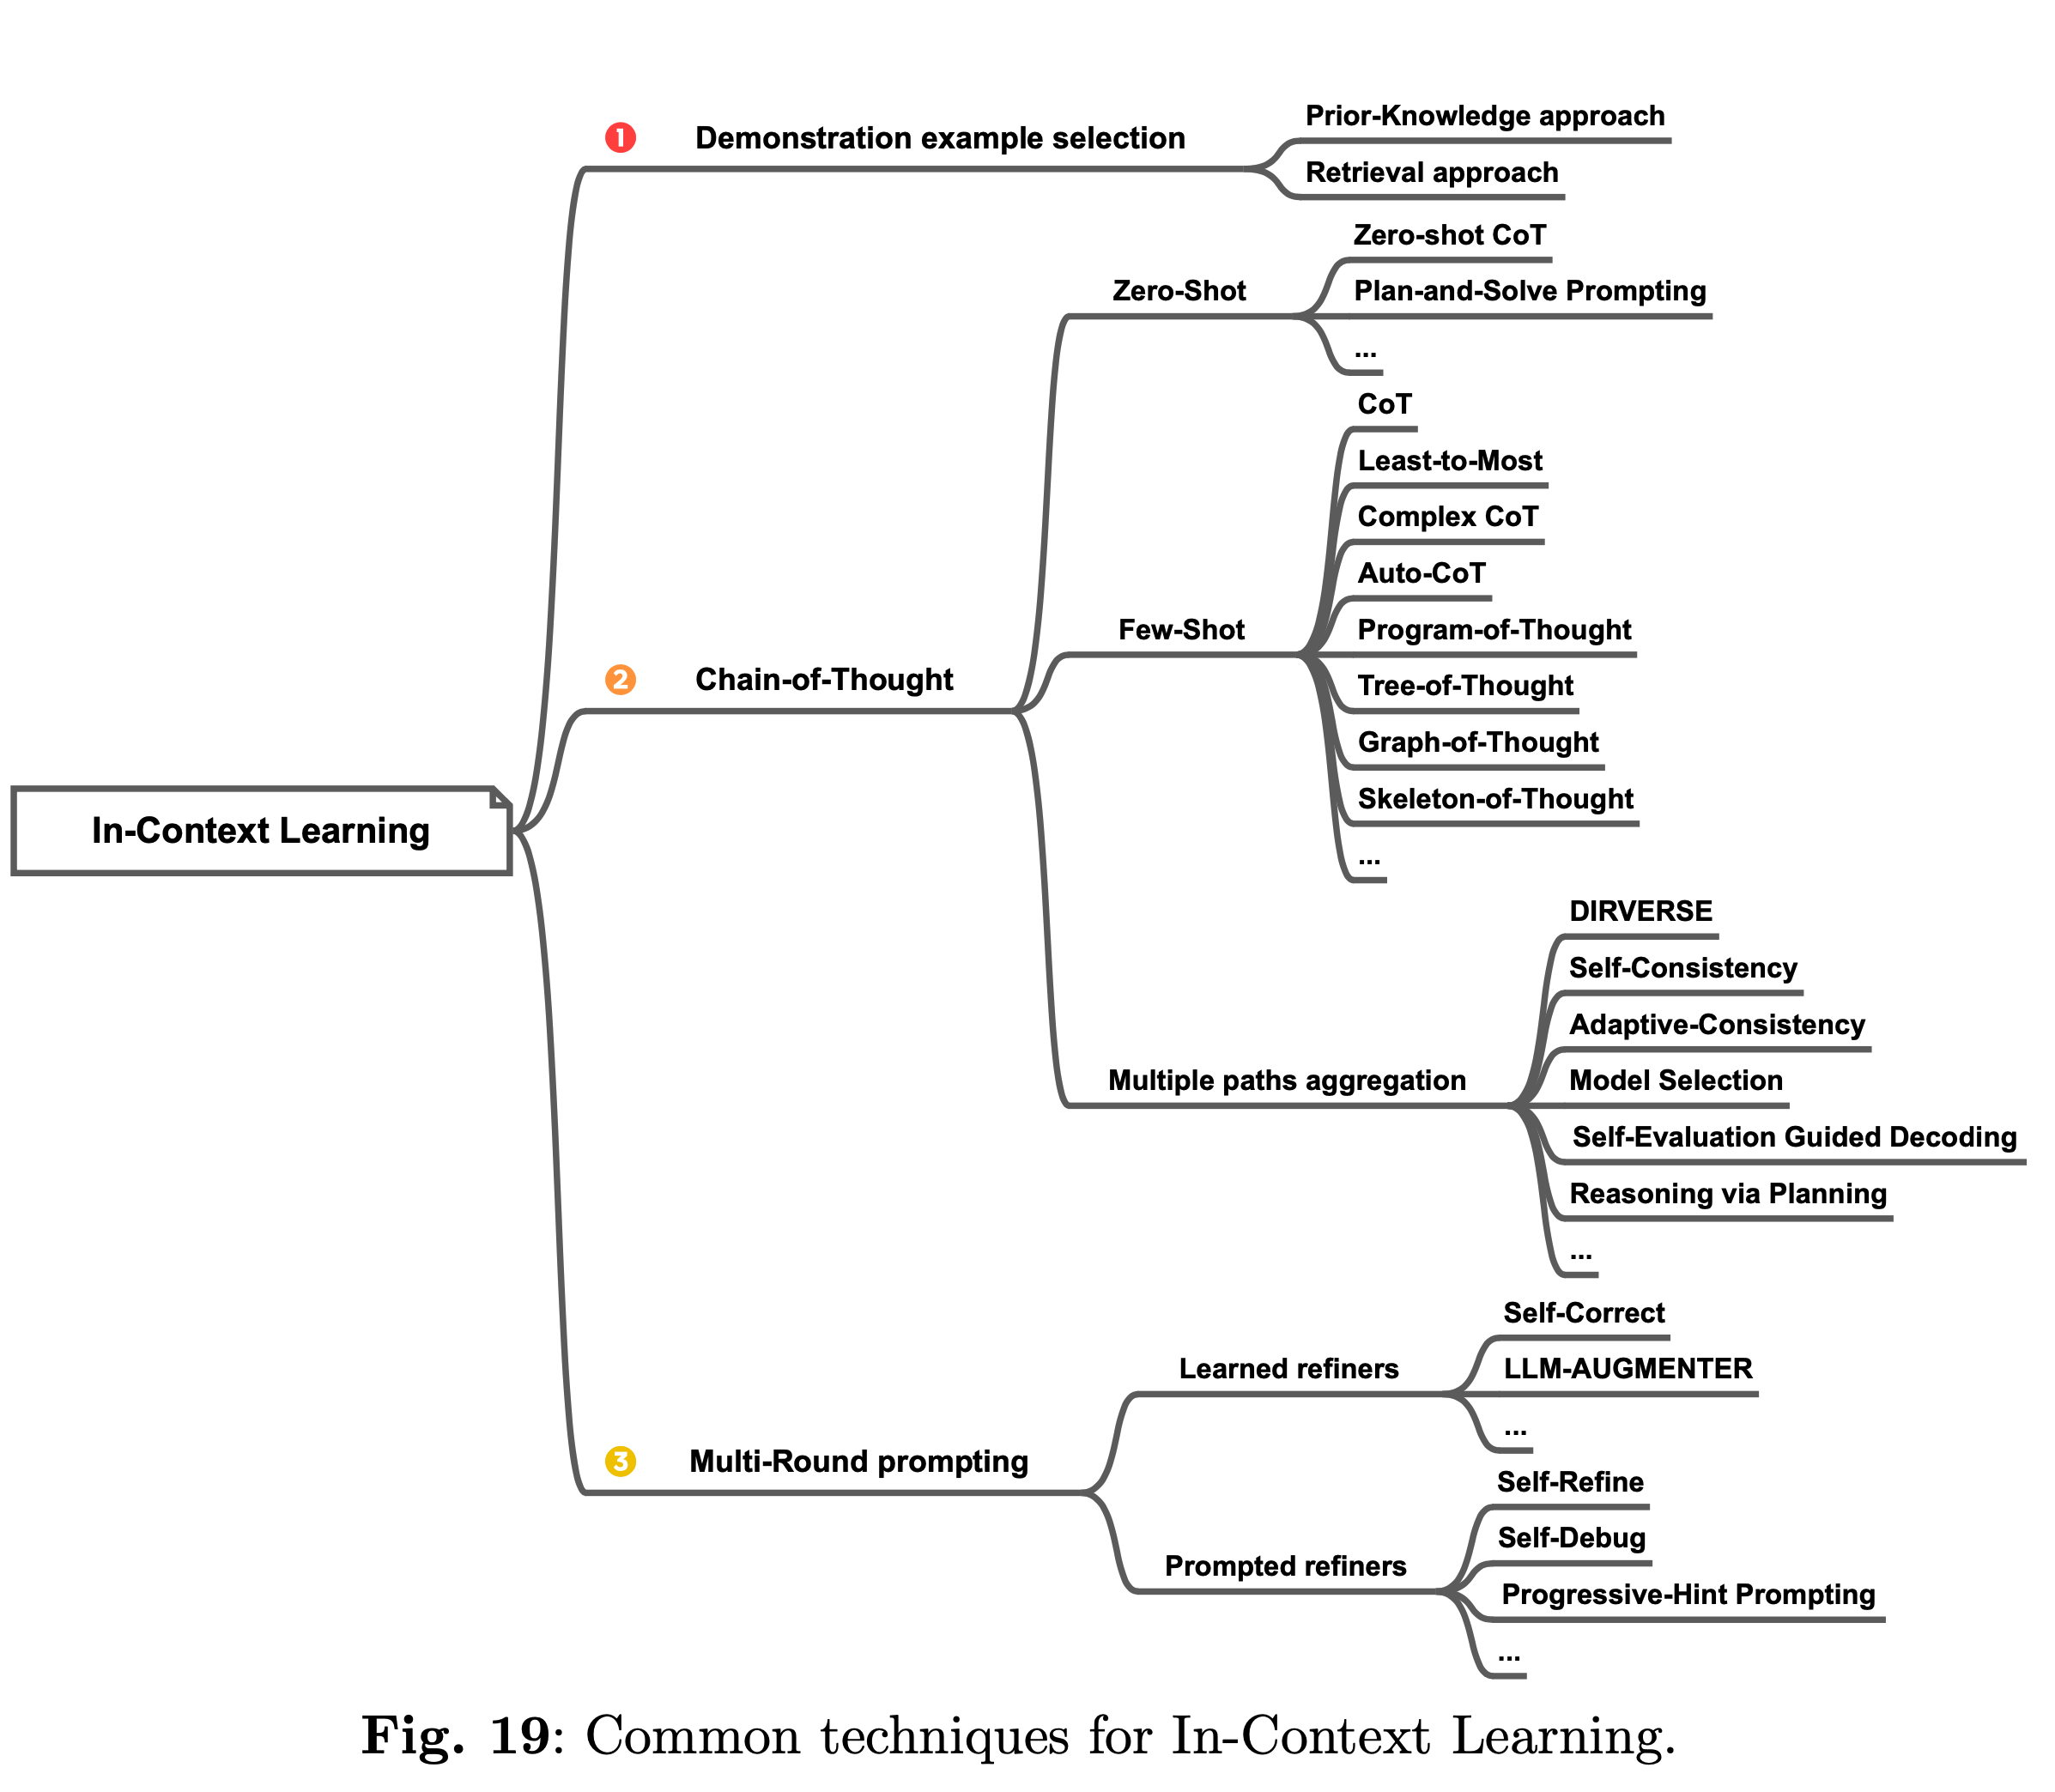
In-Context Learning
Retrieval Approach Another area of research is dedicated to harnessing the capabilities of Language Models (LLMs) in selecting demonstrations. For instance, LLMs can be employed to directly assess the informativeness of each example by quantifying the performance improvement resulting from its inclusion, as demonstrated by Li and Qiu (2023a)

Slide 33
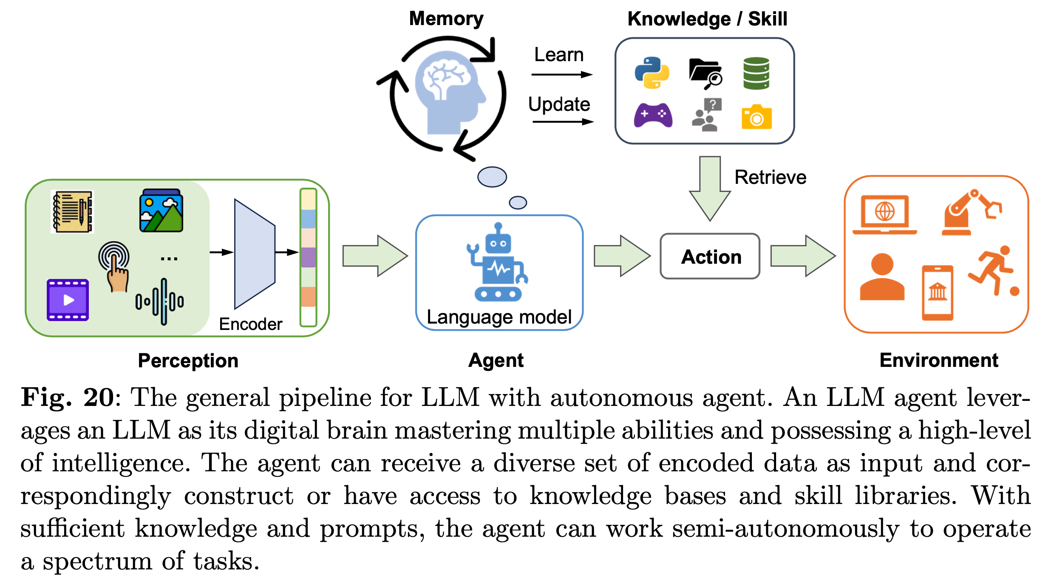
Autonomous Agent
Kind of API Augmented LLMs

Slide 34
Challenges, Limitations, and Risks
Hallucinations
Context Length
Multimodal Learning
Incredibly powerful but often underappreciated aspect of reasoning.
Applications in numerous fields where multimodal data is essential, including healthcare (such as CT, X-ray, MRI scans, and gene sequences), robotics, e- commerce, retail, gaming, and entertainment.
Efficiency and Cost
Model Pruning (Sun et al., 2023d; Wang et al., 2020): removing unnecessary connections, parameters, or layers from the model. This results in a more compact architecture, reducing computational requirements.
Compression (Zhu et al., 2023c) and Quantization (Tao et al., 2022): reduce the size of the model or reduce the precision of model parameters, using fewer bits to represent them. This reduces memory usage and computational complexity.
Knowledge Distillation (Gu et al., 2023b)
Low-Rank Factorization (Ren and Zhu, 2023; Hsu et al., 2022)
Human Preference
Multilingual Support

Slide 35
Future Directions
Safety and Privacy
Interpretability and Transparency
Autonomous Language Agents
Reasoning for Science
Super Alignment - https://openai.com/blog/introducing-superalignment
Superintelligence alignment, according to OpenAI, is the next machine-learning question of utmost importance.
Superintelligence rather than AGI to stress a much higher capability level.
Ensuring the control and alignment of potentially superintelligent AI systems poses significant challenges.

Slide 36






youtube.com/@asimmunawar
x.com/asimunawar
linkedin.com/in/asimmunawar
https://www.threads.net/@asimunawar
https://asimmunawar.github.io/ (go to Talks)
Asim Munawar

